Slide 1


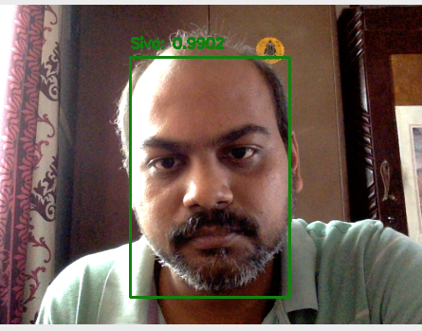
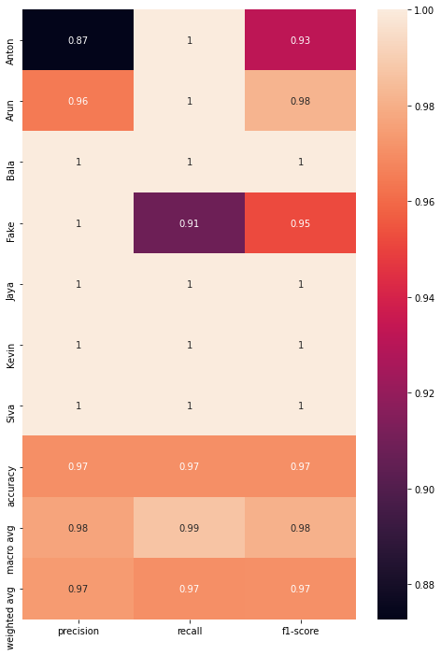
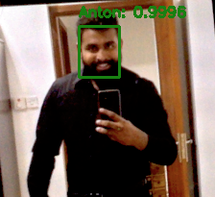

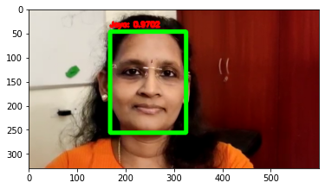
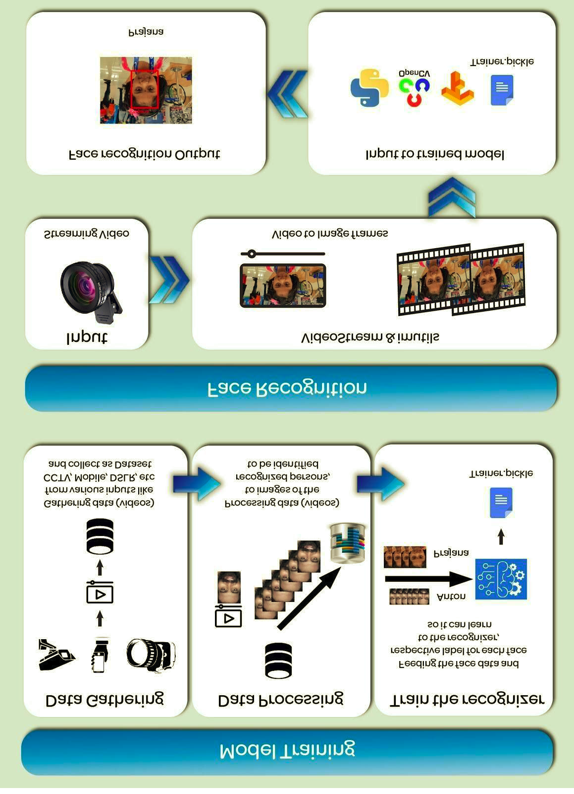
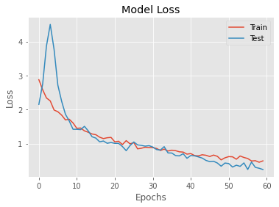
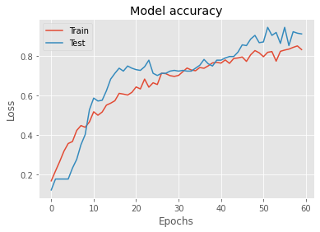
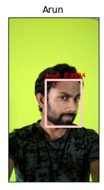
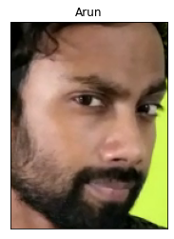
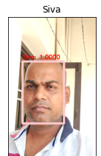
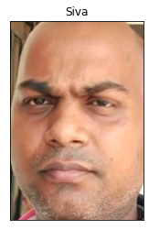
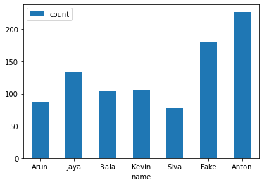
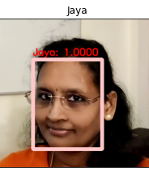

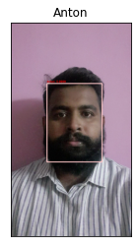
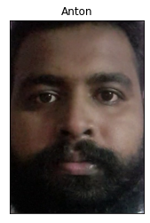
Home security system with Intruder Alert using Computer Vision
Sivakumar Panneerselvam, Anton Erone Pius, Hariharan Ramesh, Jayaseeli Joachin, Arun P
PG Program in Artificial Intelligence & Machine Learning
ABSTRACT
INTRODUCTION
MODEL
RESULT
Providing reliable security for homes in the absence of a house owner is crucial
nowadays. In this project, we present a
solution for home security systems, using
Computer Vision. We use OpenCV library
to implement Face detection and Face
recognition algorithms in python.
The implemented system depends on the
SSD framework on ResNet and CNN. It
recognises faces captured on the security
camera installed at home, in a shorter time with better accuracy.
This system can scale well when new
training data are uploaded often to
authenticate known reliable faces.
Provision of home security services has become an
integral part of our lives in today’s technological society where attackers usually have all the necessary means
and resources at their disposal. The traditional home
security system, i.e. closed circuit television (CCTV) can only capture and record the video without being able to
give warning feedback if there is any suspicious /
unauthorised human activities within the perimeter.
In light of this problem we have developed a unified
intruder alert system with face recognition. The face
detection module differentiates between authorised
people and intruders. With the video footage of the
authorised personnel, using OpenCV and Tensorflow the model is trained to identify all the authorised personnel.
SSD framework on ResNet is used to identify the position of the face from the input image frames. We train the model with different facial features such as beard, spectacles etc., to make sure the authorised person aren't classified as intruders, in addition the fake face / face liveness detection is implemented to identify the intruder from the authorised personnel's face mask / picture. Once the intruder is identified an alert message is triggered to all the authorised personals.
LivenessNet is the model is being used for this project to apply liveness detection
To create our liveness detection we utilized OpenCV, Deep Learning, and Python.
The first step was to gather our real vs. fake dataset. To accomplish this task, we:
1. First recorded a video of ourselves using our smartphone (i.e., “real” faces).
2. Held our smartphone up to our laptop/desktop, replayed the same video, and then recorded the replaying using our webcam (i.e., “fake” faces).
3. Applied face detection to both sets of videos to form our final liveness detection dataset.
After building our dataset we implemented, “LivenessNet”, a Keras + Deep Learning CNN.
This network is purposely shallow, ensuring that:
1. We reduce the chances of overfitting on our small dataset.
2. The model itself is capable of running in real-time (including on the Raspberry Pi).
Overall, our liveness detector was able to obtain 90+% accuracy on our validation set.
Result of the Face Recognition model is the identified person’s name from the live video, with a bounding box over face and with confidence level mentioned.
Siva 0.9802 Classification Report
Anton 0.9966
Jaya 0.9702
CONTACT
METHODS
ARCHITECTURE
EVALUATION
CONCLUSIONS
Sivakumar Panneerselvam
Greatlearning, Chennai, INDIA
sivakumar.panneerselvam@gmail.com
Anton Erone Pius
Greatlearning, Chennai, INDIA
eronepius@gmail.com
Hariharan Ramesh
Greatlearning, Chennai, INDIA
hariharan.rs33@gmail.com
Jayaseeli Joachin
Greatlearning, Chennai, INDIA
jseelibala@gmail.com
Arun P
Greatlearning, Chennai, INDIA
arun.agnitio@gmail.com
The solution begins with identifying all the users who
have clearance for entering the given secured space
(eg, home, office buildings). The identified users are
then taken a video of 10 to 15 secs in all the possible
angles. These videos will serve as the training dataset
for the model. The videos taken will have all kinds of
background and in this case we need to consider them
as noise.
The facial embedding is retrieved using a caffe model -
res10_300x300_ssd_iter_140000.caffemodel , along with this model there is a predefined weights that is available, using which the face embeddings are retrieved and
stored locally. With this the training dataset preparation
and preprocessing is completed.
The model defined in this project is a simple tensorflow model which has a total params: 148,822 . The model is designed as a light-weight model so that it can be deployed in a raspberry
pi system.
Using the open-cv module we parse the video feed through the model to identify and recognise the face. The model can predict the faces with 90+% accuracy .
Thus, we implemented a home security system with
Intruder alert, there are some limitations in this system, which is, limited dataset, continuation of model training
whenever new dataset is being generated, and
communication to the admin / user of this system with
applications like Slack
We have implemented LivenessNet model to identify
fake / real persons and we have used pre trained Caffemodel to identify the face positions
REFERENCES
G. Kim, S.Eum, J. K. Suhr, D. I. Kim, K. R. Park, and J, Kim, Face liveness detection based on texture and frequency analyses, 5th IAPR International Conference on Biometrics (ICB), New Delhi, India. pp. 67-72, March 2012.
J. Maatta, A. Hadid, M. Pietikainen, Face Spoofing Detection From Single images Using MicroTexture Analysis, Proc. International Joint Conference on Biometrics (UCB 2011), Washington, D.C., USA.
sooyeon Kim, Sunjin Yu, Kwangtaek Kim, Yuseok Ban, Sangyoun Lee, Face liveness detection using variable focusing, Biometrics (ICB), 2013 International Conference on, On page(s): 1 – 6, 2013.
H. K. Jee, S. U. Jung, and J. H. Yoo, Liveness detection for embedded face recognition system, International Journal of Biological and Medical Sciences, vol. 1(4), pp. 235-238, 2006.
FACE DETECTION

